Slide 1
Henry Clay’s American System Nationalism v. Sectionalism American System

Slide 2
Main Idea
Patriotic Pride after the War of 1812 united the states but tension between the North and South emerged
Matters now because it led to the Civil War
Still regional differences today
Notes:
American System - devised in the burst of nationalism that followed the War of 1812, remains one of the most historically significant examples of a government-sponsored program to harmonize and balance the nation's agriculture, commerce, and industry. This "System" consisted of three mutually reenforcing parts: a tariff to protect and promote American industry; a national bank to foster commerce; and federal subsidies for roads, canals, and other "internal improvements" to develop profitable markets for agriculture.

Slide 3
Nationalism Vs. Sectionalism
Nationalism
Sectionalism
Nationalism: Feeling of pride, loyalty and protectiveness towards your country
Henry Clay: strengthen country and unify regions
Sectionalism: Loyalty to the interests of your own region or section of country rather than the nation as a whole
Threatening to drive country apart
Economic divisions

Slide 4
American System: Introduction
In 1815, President James Madison presented a plan to Congress that would help unite the different regions of the United States. President Madison wanted to create a self-sufficient country that would maintain a stable economy, and develop a united country.
Three major points of the American System:
1. Developing transportation systems
2. Establishing a protective tariff
3. Resurrecting the national bank

Slide 5
American System: Definition
What is Henry Clay’s American System?
House Speaker, Henry Clay coined the term “American System” in 1815, after President Madison created a plan to unite the Northern and Southern economies.
*Nationalism and Sectionalism Growing at the same time

Slide 6
The American System
STEP 1: A tariff (a tax on imported goods)
Made European goods more expensive
Encouraged Americans to buy cheaper products made in America
Made the country money, used for national improvements
South pays more for the same good
Developments include…
1816- President James Madison proposes a tariff that would tax all imported foreign goods.
The north encouraged the tariff because it would improve the their economy and increase total profits.
The south and west discouraged the tariff because they would have to pay more for the same products.

Slide 7
Step 2: A National Bank
Stabilize/ strengthen the currency and rein in risky banks
Developments include…
1816- The Second Bank of the United States (BUS) was approved for a 20-year term by the Congress.
The bank charter would establish a national, guaranteed currency, that would improve national and regional trading of goods and services.
1816- James Monroe (VA) is elected US President.
Begins a new presidency, “Era of Good Feelings!”

Slide 8
Step 3: Transportation
Build many more roads and canals
Paid for by the money made from the tariff
Developments include…
1807- Robert Fulton’s Clermont makes its maiden voyage, 150 miles from New York City to Albany.
1811- Construction of the National Road begins between Cumberland, MD and Vandalia, Il.
1825- Erie Canal opens a 363-mile waterway that connects the Hudson River to Lake Erie.
1825- First steam locomotive was used to transport goods across different regions of the country.
1838- National Road opens to the public, tolls are required to help offset construction costs.

Slide 9
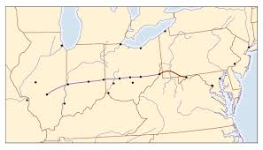
National Road

Slide 10
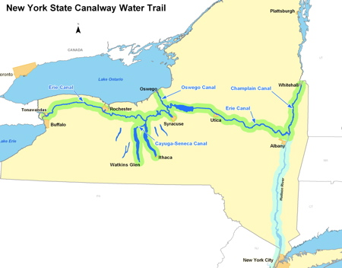
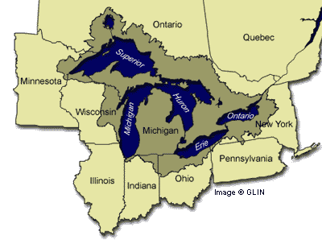
Erie Canal

Slide 11
Venn Diagram: North v. South
Task: (PUT IN NOTEBOOK)
Compare and contrast the North and South economies using a Venn diagram. Think about the economy

Slide 12
North Economy:
Northern Economy: Strengths
1. The north had just experienced an Industrial Revolution, and was producing manufactured goods.
2. New methods of transportation that brought goods to and from the manufacturing north.
3. A new, national currency that enabled the north to trade with the south and west.
Northern Economy: Weaknesses
1. Poor soil, low crop production, few livestock.

Slide 13
Southern/Western Economy:
Southern/Western Economy: Strengths
1. Good and rich soil for plantation farming.
2. Increased slavery, increased productivity.
3. Use of the Mississippi River for transportation of goods between the north and south economies.
Southern/Western Economy: Weaknesses
1. No factories for manufacturing goods.
2. Heavy, intense labor needed to run the plantations smoothly in the south.

