Slide 1
Missouri Compromise

Slide 2
Background
22 states in the country – 11 free and 11 slave
Missouri applied to be a slave state in 1819
First state from the Louisiana Purchase
We want a balance!!
SO now what do we do?

Slide 3
A Problem Develops . . . .
If Missouri becomes a slave state then slave states would outnumber free states.
The Missouri question became a heated debate that dragged on for months.

Slide 4
The Bigger Problem
Congress
Remember, 2 senators from each state in Congress.
If there is an uneven number of slave vs. free states then what will happen in Congress?

Slide 5
Henry Clay
Congressman from KENTUCKY ☺ (Ashland)
Didn’t go to school – taught himself law
Tried running for President 5 times
Henry Clay AKA The Great Compromiser

Slide 6
Super Clay to the Rescue
Henry Clay worked on this problem for months.
Henry Clay owned slaves but did not want to see the question of slavery tear the nation apart.
He persuaded Congress to agree to a compromise.

Slide 7
Missouri Compromise
AKA Compromise of 1820
******3 Parts ******
1. Missouri will become a slave state
2. Maine will become a free state (land from Massachussetts)
3. An imaginary line is drawn at 36 , 30'N. Slavery was allowed South of the line in the Louisian Purchase and banned North of it.
More land in the North

Slide 8
Promblem Solved?
EHHH? Kinda
Yes, because it kept balance and worked for 34 years
No, because Jefferson said it would eventually erupt

Slide 9
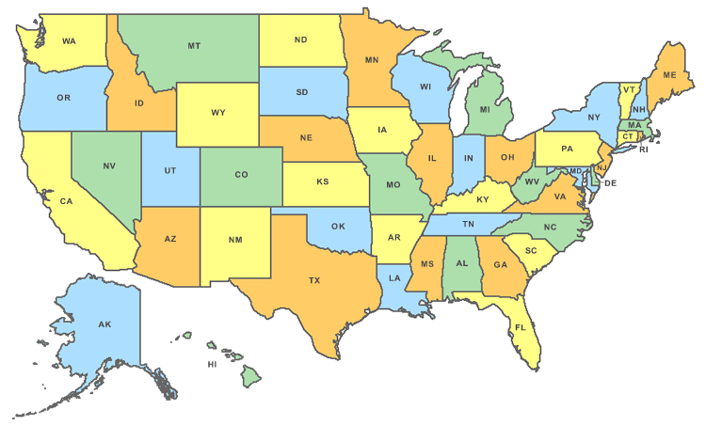
• An imaginary line was drawn across the southern border of Missouri at the latitude 36 30'N.
36 , 30’

Slide 10
Missouri Compromise Interactive Map

Slide 11
Quote by Abraham Lincoln.
“‘A house divided against itself cannot stand.’ I believe this government cannot endure permanently half slave and half free. I do not expect the Union to be dissolved – I do not expect the house to fall – but I do expect it will cease too be divided. It will become all one thing, or all the other. Either the opponents of slavery will arrest the further spread of it…or its (supporters) will push it forward till it shall become…lawful in all the states, old as well as new, North as well as South.”
What point is Lincoln making about the future faced by the United States?

