Slide 1
The World of the North

Slide 2
Geography
Climate: 4 seasons - but the states all the way up North had long winters and short summers
Bays and harbors – Boston seaport
Shipbuilding and fishing
Rivers – farming from rich soil

Slide 3
New England Forests – timber for shipbuilding
Central Plains – Ohio to Illinois farms
Changing landscape
Deforestation = clearing out forests

Slide 4
Economy
“If cotton is the king in the south, inventiveness ruled the north”
Products were made cheaper and quicker
More affordable good put skilled people out of work
Industrial Revolution = shift from hand use to machines

Slide 5
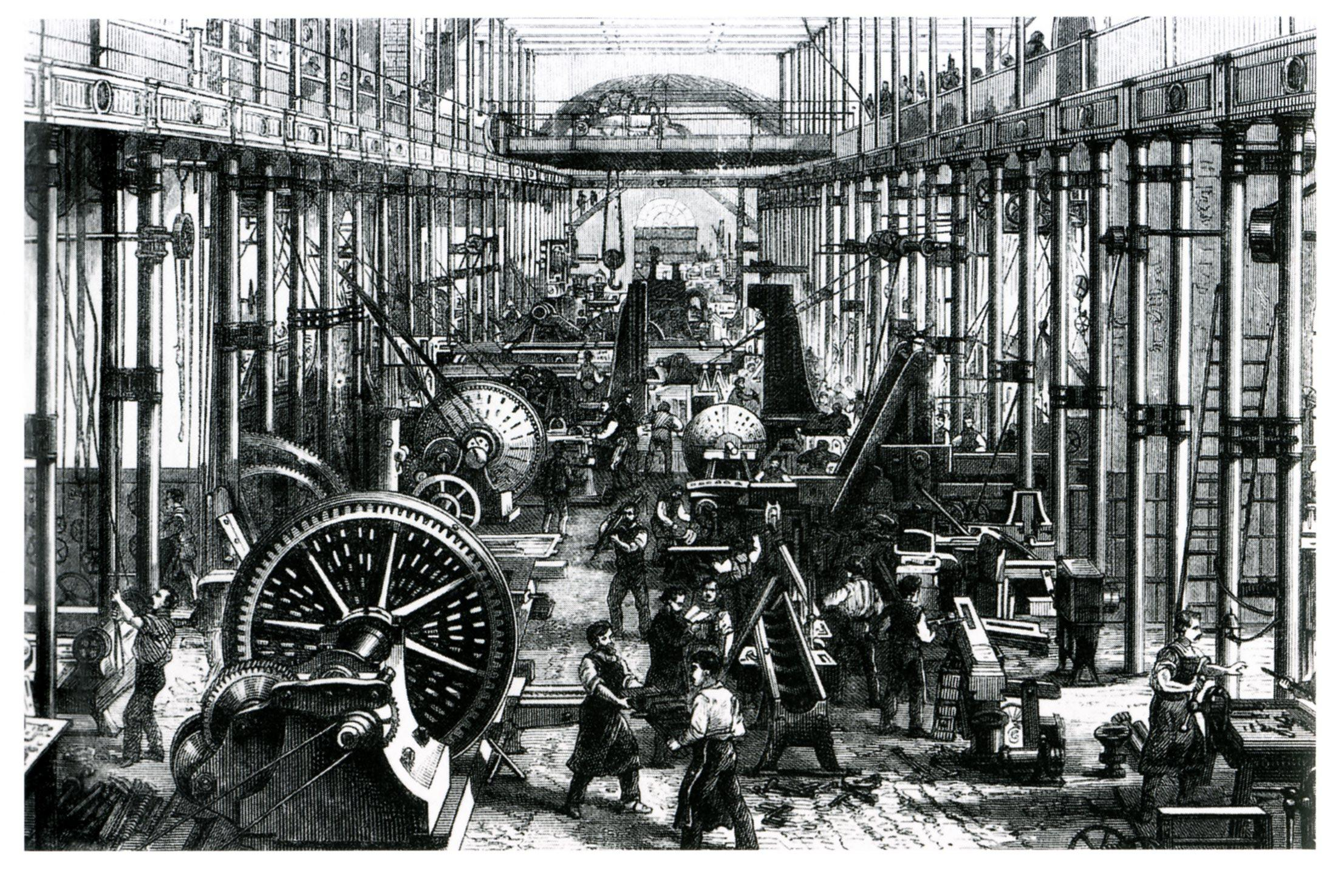

Slide 6
1810 – Francis Cabot Lowell created 1st American textile factory with machines
“Take your bale of cotton in at one end and it gave out yards of cloth at other end after goodness knows what digestive process”
Lowell girls = farm girls who worked the factories under hard conditions

Slide 7
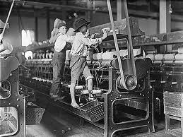

Slide 8
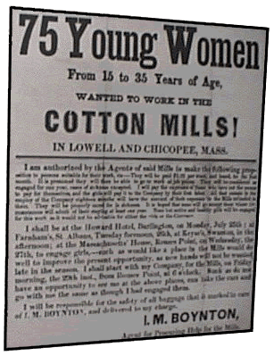

Slide 9
1830s – steam engines to power factories anywhere
not just near the river
Eli Whitney – make cheaper products from identical, interchangeable parts
“Wage slaves”
1831 Cyrus McCormick built reaper
Cut 28 times more grain than man
Reaper factory responsible for Bread Basket

Slide 10
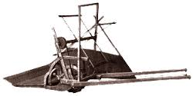

Slide 11
Transportation
Needed a fast and cheap way to transport goods
1806 National Road – tie Western states with East coast
1807 Steamboat – Robert Fulton uses steam engines to power ships against the current

Slide 12
Eerie Canal – connect Northeast with Central Plains
Steam powered trains
Railroads were North’s biggest business

Slide 13
Society
More people moving to cities, especially in Northeast
NY, NJ, Philly tripled population between 1840 to 1860
No sewers or paved words = diseases

Slide 14
African Americans – free but not equal
No voting, office position, juries or presence in white churches and schools
Immigrants – 4 million between 1840-1860:
Most from Ireland and Germany
Found jobs in factories
Faced discrimination

Slide 15
